Slide 1
Adapter pattern
It’s very often used in systems based on some legacy code. In such cases, Adapters make legacy code with modern classes.
Adapter pattern works as a bridge between two incompatible interfaces. This type of design pattern comes under structural pattern as this pattern combines the capability of two independent interfaces.
This pattern involves a single class which is responsible to join functionalities of independent or incompatible interfaces

Slide 2
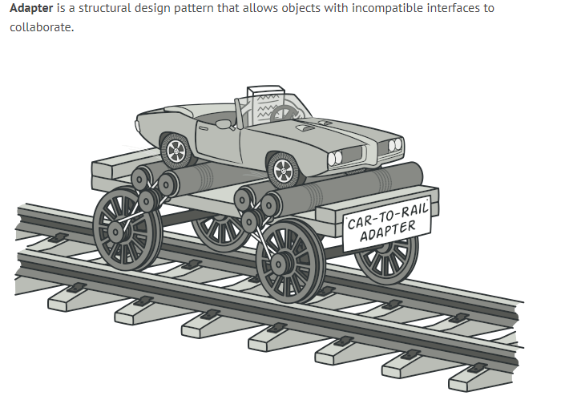

Slide 3
Real example
A real life example could be a case of card reader which acts as an adapter between memory card and a laptop
You plugin the memory card into card reader and card reader into the laptop so that memory card can be read via laptop.

Slide 4
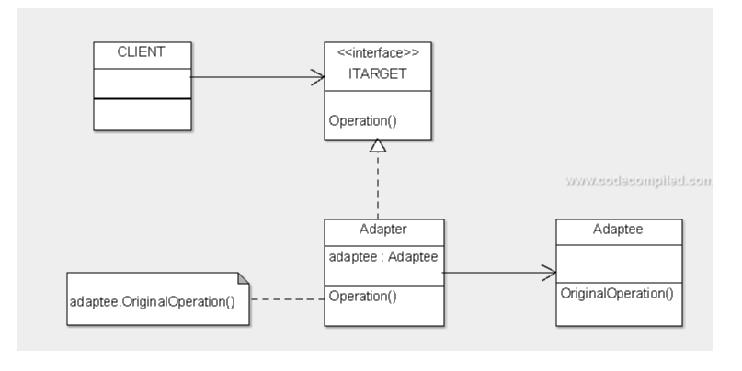

Slide 5
implementation
Adapter is recognizable by a constructor which takes an instance of different abstract/interface type.
When the adapter receives a call to any of its methods, it translates parameters to the appropriate format and then directs the call to one or several methods of the wrapped object.

Slide 6
Lets see an example in c#

